Slide 1
Performance evaluation of TDMA vs CSMA-CA
Name USN
Glenn Elish Peter 4NM19EC055
Gowtham 4NM19EC056
Guruprasad Nayak 4NM19EC057
H Pranav Nayak 4NM19EC058
Department of
Electronics & Communication Engineering

Slide 2
Introduction
Time Division Multiple Access (TDMA) is a probabilistic Media Access Control (MAC) protocol which is a channel access method for shared medium networks.
Carrier Sense Multiple Access (CSMA) is also a probabilistic MAC in which a node verifies the absence of other traffic before transmitting on a shared transmission medium.
TDMA has a larger delay time than CSMA/CA, but TDMA delay is more stable. Hence TDMA is considerably a better protocol then CAMA/CA.
Department of ECE
02

Slide 3
Objectives
Using “Network Simulator-2” to simulate the data transfer in TDMA protocol and CSMA protocol, and compare their performances.
Writing codes about TDMA protocol and CSMA protocol for NS2, and run the simulation..
Using the delay.awk to filter out all useful data and save into TDMA or CSMA file.
Using X-graph to plot the end-to-end delay of two different protocols in the same graph.
Department of ECE
03

Slide 4
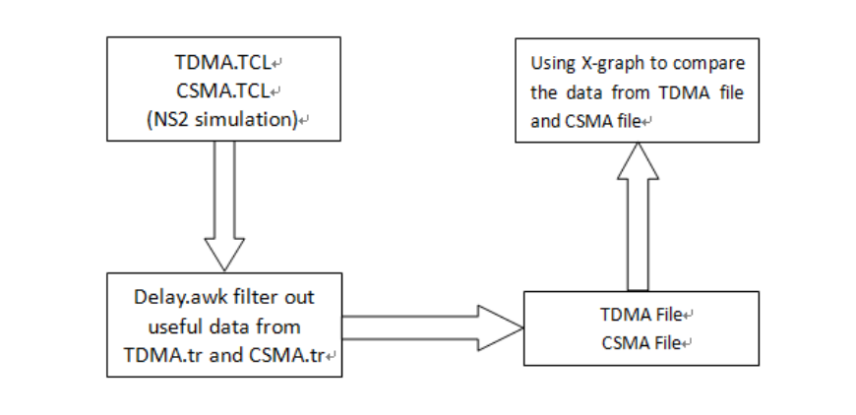
Methodology
Department of ECE
04

Slide 5
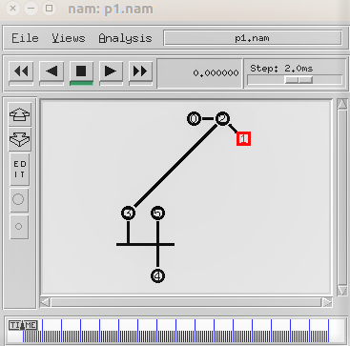
Results
A topology is created by considering six sensor nodes numbered from 0-5 as shown in Figure 1.
Figure 1. Topology displayed using Network Animator
Department of ECE
05

Slide 6
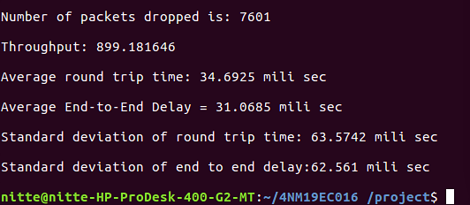
Results
Figure 2. Output obtained on terminal window
Department of ECE
06

Slide 7
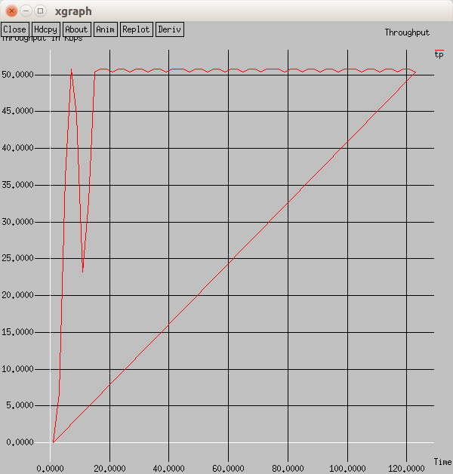
Results
The trace file is obtained and a graph of throughput vs time is plotted as shown in Figure 3.
Figure 3. Throughput vs Time
Department of ECE
07

Slide 8
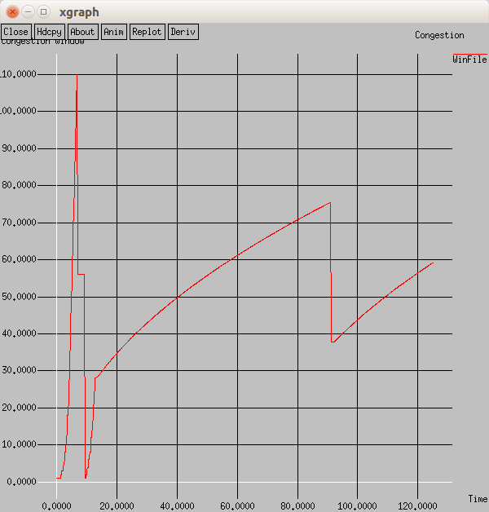
Results
Congestion window vs time as shown in Figure 4 is plotted
2
3
1
Figure 4. Congestion window vs Time
Department of ECE
08

Slide 9
References
Zhang, Shu & Sun, Qiao & Gao, Qing & Wang, Min & Zhang, Yu. (2014). Research on TCP Congestion Control Mechanisms. Advanced Materials Research. 989-994. 4427-4431. 10.4028/www.scientific.net/AMR.989-994.4427.
Oliver Gasser “TCP/IP communication in a WSN”, Seminar SN SS2011, Network Architectures and Services, July 2011, doi: 10.2313/NET-2011-07-1_11
M. Ahmad et al., "End-to-End Loss Based TCP Congestion Control Mechanism as a Secured Communication Technology for Smart Healthcare Enterprises," in IEEE Access, vol. 6, pp. 11641-11656, 2018, doi: 10.1109/ACCESS.2018.2802841.
Dunkels, Adam & Alonso, Juan & Voigt, Thiemo & Ritter, Hartmut & Schiller, Jochen. (2003). Connecting Wireless Sensornets with TCP/IP Networks. Lecture Notes in Computer Science. 10.1007/978-3-540-24643-5_13.
Department of ECE
09

Slide 10
Thank You
Department of ECE
010

